Slide 1
Cluster 4 - Digital, Industry and Space
Overview & Opportunities for Newcomers
Nicholas Deliyanakis
DG Research & Innovation
European Commission
Notes:
This presentation covers the general principles of Cluster 4, principally in the period 2021-24, highlighting some features of interest to newcomers, including the hop-on facility. It does not cover the current WP 2021-22 or the future WP 2023-24.

Slide 2
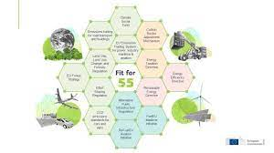
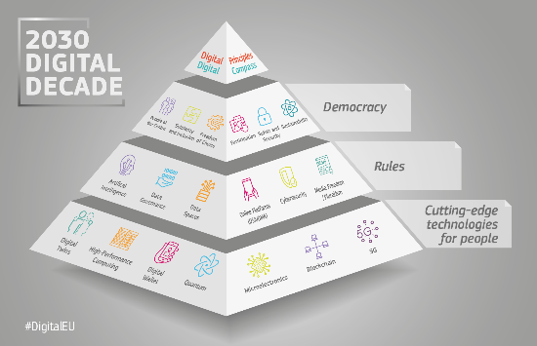
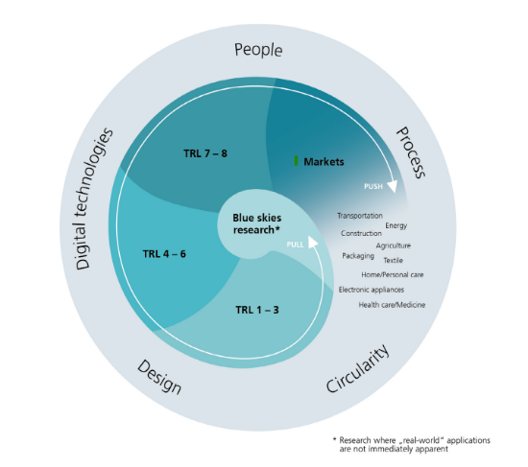
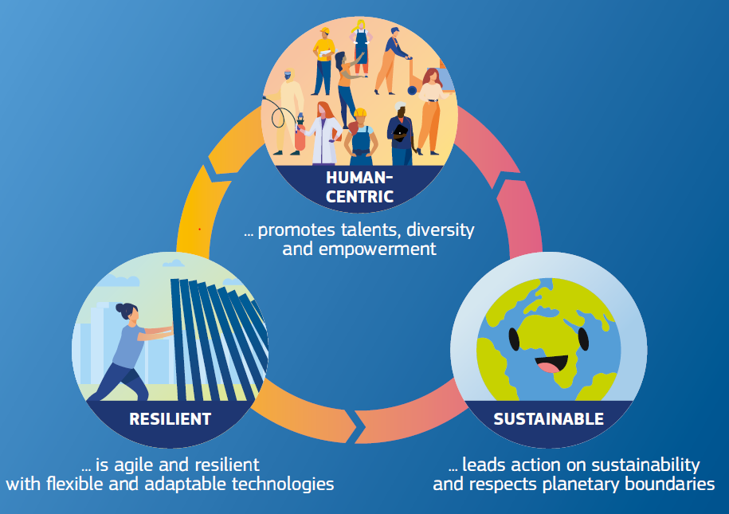
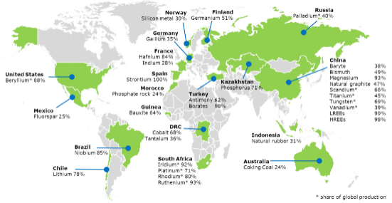
Cluster 4 ‘Digital, Industry and Space’ – Policies, Strategies, Action Plans
Updated
European Industrial Strategy
Notes:
There are several key EU| policies underpinning Cluster 4. Through the expected outcomes of topics and the expected impact associated with each ‘Destination’, each funded project contributes to one or more of these policies.

Slide 3
Cluster 4 – Vision
Competitive technologies respecting the boundaries of our planet, and reflecting human needs
Climate-neutral, circular and clean industry
Innovative production and manufacturing processes
Sustainable-by-design advanced materials and technologies
Deep decarbonisation of energy-intensive industries
Twin Green and Digital Transitions
Industrial and Digital transformation
mastering technologies
deploying technologies – technology infrastructures
securing autonomy in strategic value chains and critical raw materials
VISION
Frame photo created by Waewkidja - www.freepik.com
Major contribution to Inclusiveness and Resilience
engagement with users, workers, citizens
development of skills
development of regions
Notes:
Horizon Europe will continue to support the Key Enabling Technologies:
life sciences
advanced manufacturing technologies
advanced materials and nanotechnologies
micro-/nano-electronics and photonics
artificial intelligence
security and connectivity.
KETs are paramount in taking excellent science to the market, and to ensure the success of innovations made in Europe. The KETs will be crucial to increase the impact of the European Innovation Council, and will enable the achievement of the goals for Global Challenges.

Slide 4
Cluster 4 - Digital, Industry and Space “Destinations” 2021-22 & 2023-24
Key Strategic Orientation in the Strategic Plan 2021 - 2024 | Destination | Strategies
Making Europe the first digitally enabled, circular, climate-neutral and sustainable economy | Climate neutral, circular and digitised production TWIN-TRANSITION | Fit for 55 Digital Decade Industrial Strategy
Promoting an open strategic autonomy by leading the development of key digital, and enabling and emerging technologies, sectors and value chains | A digitised, resource efficient, and resilient industry RESILIENCE | Fit for 55 EU Chemical Strategy Industrial Strategy
 | World-leading data and computing technologies DATA | Digital Decade Industrial Strategy
 | Digital and emerging technologies for competitiveness and fit for the green deal DIGITAL-EMERGING
 | Open Strategic Autonomy in developing, deploying and using global space-based infrastructures, services, applications and data SPACE | EU Space Strategy
Creating a more resilient, inclusive and democratic European society | A human-centred and ethical development of digital and industrial technologies HUMAN | Digital Decade Industrial Strategy
The Key Strategic Orientation “restoring Europe’s eco-sytems and biodiversity” becomes increasingly important for cluster 4
Notes:
Cluster 4 has six expected impacts in the Strategic Plan 2021-23, which inform the six ‘Destinations’ in both the WP 2021-22 and the future WP 2023-24.

Slide 5
Cluster 4 Synergies - Overview
EIT Manu-
facturing
EIT Raw Materials
TWIN TRANSITION
PARC
European Defence Fund
Innovation
Fund
EIT
InnoEnergy
06
01
RESI- LIENCE
HUMAN
05
02
Digital
Europe
Programme
(DEP)
Clean
Hydrogen
JU
SPACE
04
03
DATA
EU
Space
Programme
DIGITAL / EMERGING
EIT Digital
ERDF
ESF+
InvestEU
COSME-SMP
Notes:
Cluster 4 has potential synergies to many other programmes, most notably – but not only – for the deployment of technologies. Please refer to more specialised presentations on each programme.

Slide 6
Partnerships in Cluster 4
Processes4Planet – Transforming the European Process Industry for a sustainable society (1,300M€)
Clean Steel – Low-carbon Steelmaking (700M€)
Made in Europe (900M€)
EuroHPC, High-Performance Computing (JU, 900M€)
KDT, Key Digital Technologies (JU, 1,800M€ + Chips)
SNS, Smart Networks and Services (JU, 900M€)
Artificial Intelligence, Data and Robotics (1,300M€)
Photonics (340M€)
Globally competitive Space Systems (proposed)
Metrology (Art. 185, 300M€)

Slide 7
Indicative Budget of Cluster 4
2021-27 budget of ~15 bn€ (including NGEU)
For the WP 2021-2022, the programmable budget was ~3.5 bn€, distributed as:
DESTINATION | BUDGET 2021-2022
Destination ‘Climate neutral, circular and digitised production’ | 737.5 M€
Destination ‘Increased autonomy in key strategic value chains for resilient industry’ | 776.4 M€
Destination ‘World leading data and computing technologies’ | 346.0 M€
Destination ‘Digital and emerging technologies for competitiveness and fit for the green deal’ | 750.0 M€
Destination ‘Open Strategic autonomy in developing, deploying and using global space-based infrastructures, services, applications and data’ (incl. Other Actions) | 517.6 M€
Destination ‘A Human-centred and ethical development of digital and industrial technologies’ | 327.0 M€
Other Actions (other than Space-related) | 36.0 M€

Slide 8
Social Sciences and Humanities (SSH)
Involving Social Sciences and Humanities can significantly enhance the outcomes of many projects in Digital, Industry and Space. Examples include
Human-robot collaboration, Human empowerment
Improving working environments
Engaging with society to develop and adopt green and digital solutions
Removing biases in Artificial Intelligence
Trustworthiness in Next-generation Internet and Artificial Intelligence
Role of Social Sciences and Humanities explicit in 52 topics of Cluster 4
Opportunities for Social Innovation in 20 topics of Cluster 4

Slide 9
International Cooperation
General opening of Horizon Europe to international cooperation
Low- and middle-income countries can participate with EU funding
Other countries can participate, normally without EU funding, except in justified cases
International cooperation explicitly encouraged
42 topics in the WP 2021-22
flagged on portal as ‘A Stronger Europe in the World’
Associated Countries

Slide 10
HOP ON FACILITY
Policy objective: Improve Inclusiveness of Horizon Europe policy by involving research institutions from Widening countries in Horizon Europe Pillar II and EIC Pathfinder actions. It responds to requirement
fixed by legislators for widening (‘advancing Europe package’).
Call: HORIZON-WIDERA-2022-ACCESS-07-01
Type of action: RIA
Opening: 27 Jan 2022 Cut-Off dates: 20 Apr 2022; 10 Nov 2022
Indicative budget (EUR million): 40.00 Expected EU contribution per project EUR 0.2 to 0.5 million Expected number of projects to be funded: 80

Slide 11
HOP ON FACILITY: KEY FEATURES (1)
Who:
A consortium funded under Pillar II or the EIC Pathfinder actions of Horizon Europe, with a valid grant agreement but with no partner from a Widening country;
A legal entity from a Widening Country wishing to join this collaborative
R&I action.
How:
The proposal must be submitted by the coordinator of the funded consortium
All consortium partners need to agree on the accession of the new partner.
The proposal should include a detailed description of the profile of the new partner and its role in the existing project; the R&I relevance and complementarity needs to be demonstrated.
The additional partner and task should be described in a dedicated proposal template, DoA of parent project to be annexed

Slide 12
HOP ON FACILITY: KEY FEATURES (2)
Implementation:
Selected consortia will be invited to submit an amendment request for accession of a new partner, modification of the description of the action and upgrade of the budget.
Costs:
The budget increase must be exclusively for the benefit of the new partner.
An additional coordination fee of up to 10% of the increased budget can be allocated to the coordinator of the consortium.

Slide 13
HOP ON FACILITY: Expected impacts
• At system level, mobilise excellence and increase visibility of the participants from the Widening countries, improve knowledge circulation, and reduce lack of participation of Widening countries in thematic domains.
• At organisation level, open up silos of established closed consortia and improve research excellence of the Widening country’s institutions in specific fields.
• At the level of the beneficiary, provide new competencies and skills (from working in transnational projects) including on research management and dissemination and exploitation of results.

Slide 14
HOP ON FACILITY: How YOU CAN contribute to the SUCCES of this Action ?
Raise awareness amongst your national community;
Liaise with your fellow NCPs working on Pillar 2 clusters and EIC pathfinder actions;
Use informal channels to motivate coordinators of selected projects to engage with Hop On Facility if the project is eligible;
Organise matchmaking activities e.g. virtual events if appropriate;
Provide feedback to us (RTD/REA) on any challenges and good practices especially for matchmaking.

Slide 15
Thank you!
# HorizonEU
http://ec.europa.eu/horizon-europe

